Slide 1

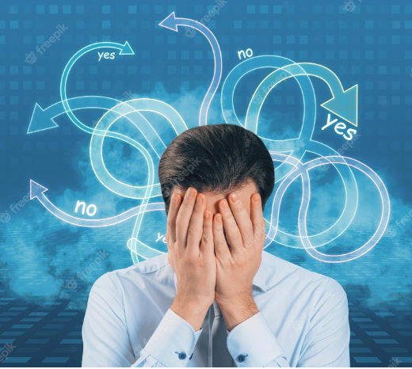

Human stress
Detection

Slide 2

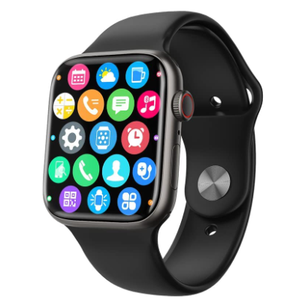
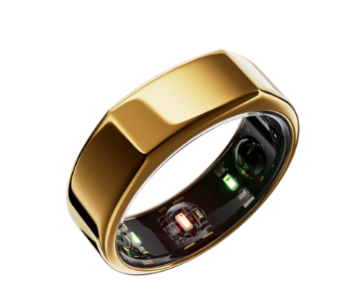

Respiration rate
12-20 breaths per minute for child
15-25 breaths per minute for adult
Eye movement
50-60% for child,adult
Blood oxygen levels
95-100% for child,adult
In General
Heart rate
60-95 bpm for child
60-100 bpm for adult
Number of hours slept
9-11 hours child sleep per day
8-9 hours adults sleep per day
Body temperature
97.9°F to 100.4°F for child
97.5°F to 98.2°F for adult
Data collection can be done using
Smart-Yoga Pillow
Wearable devices,Mobile apps
Sleep trackers
Oura ring

Slide 3
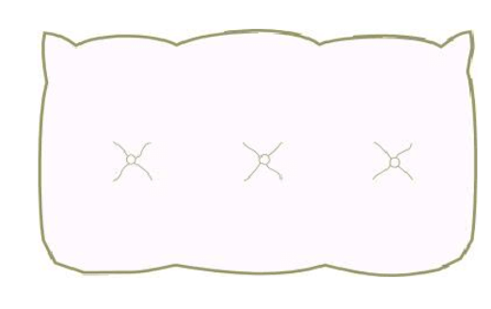
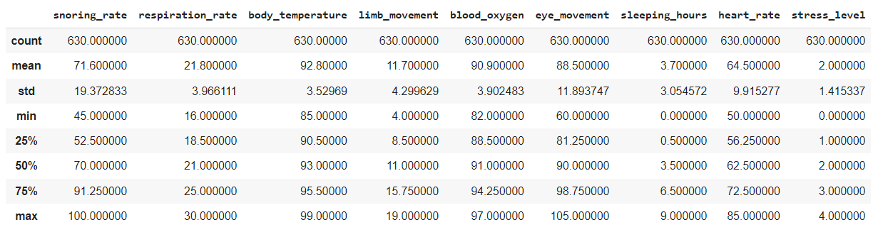
Describetion of Sleeping_Dataset
Many nowadays sleep without considering the benefits sleep brings to the human body. The Smart-Yoga Pillow (SaYoPillow) is presented as an edge device to aid in the understanding of the link between stress and sleep.
Stress Levels
(0- low/normal, 1 – medium low, 2- medium, 3-medium high, 4 -high)

Slide 4
Methodology
01
02
03
04
05
Data Preprocessing
Model training
and validation
Data collection
Development of a machine learning model
Stress detection

Slide 5

Machine learning
Logistic regressionon
Navie bayes
LightGBM
catboost
SVM
100%
98%
XGB classifier
Random forest classifier
gradient boosting regressor
98.4%
Decision tree

Slide 6

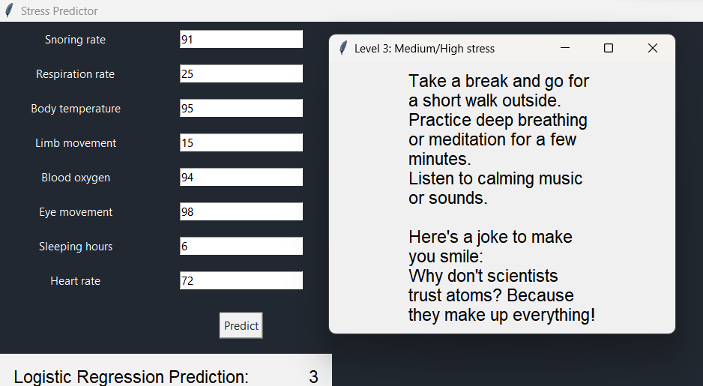
UI
using tkinter

Slide 7
T
H
A
N
K
S
Team Members 20MIA1031 - SANJAY.M 20MIA1039- SRIGANTH R 20MIA1106- MADHU KIRAN P 20MIA1117- PILLARAM MANOJ 20MIA1162 - GUNA SHANKAR.S

